Slide 1
Digital US is a national collective impact coalition to ensure that all of US have technology skills and digital resilience to thrive in work and life.
www.DigitalUS.org

Slide 2
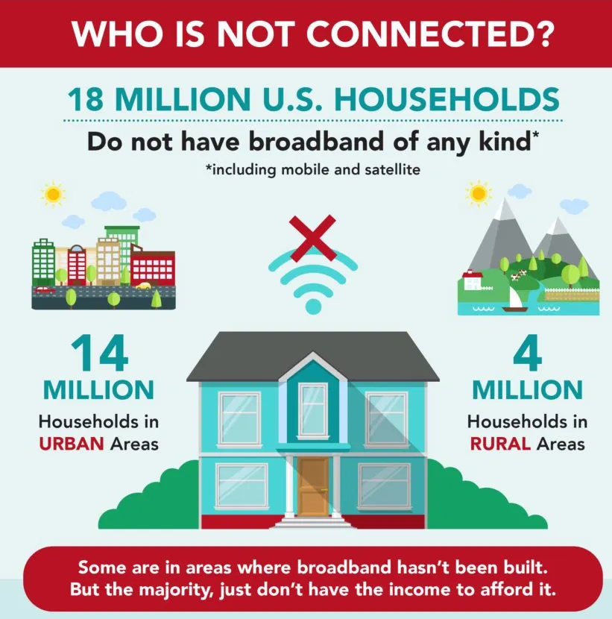
Digital Navigator Services

Slide 3
