Slide 2
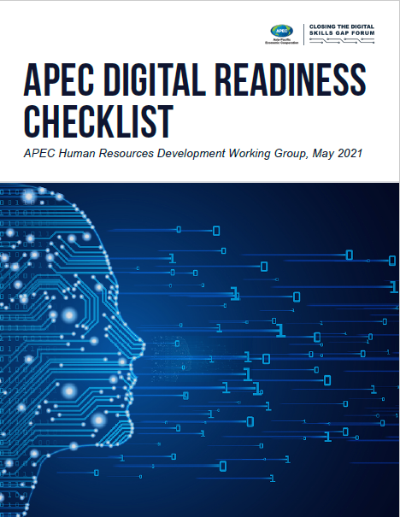
Digital Readiness
To help APEC governments, employers, and academia understand their levels of preparedness for jobs in the digital age and to support efforts to upskill and reskill workers amidst COVID-19.
The Checklist is intended to serve as a resource for all stakeholders in APEC economies with the ability to influence, develop and implement policies and programs to close the digital skills gap – these may include labor, education, and economic officials in APEC member economies; the private sector; academia; and other stakeholders.

Slide 3
Timeline – APEC Digital Readiness
March 2020 – April 2021 | April – May 2021
Development of APEC Digital Readiness Checklist: Created initial draft Stakeholder consultations (July 2020, review by US Department of Labor, April 2021, final review) | APEC Review and Endorsement: Endorsed by Human Resources Development Working group

Slide 5
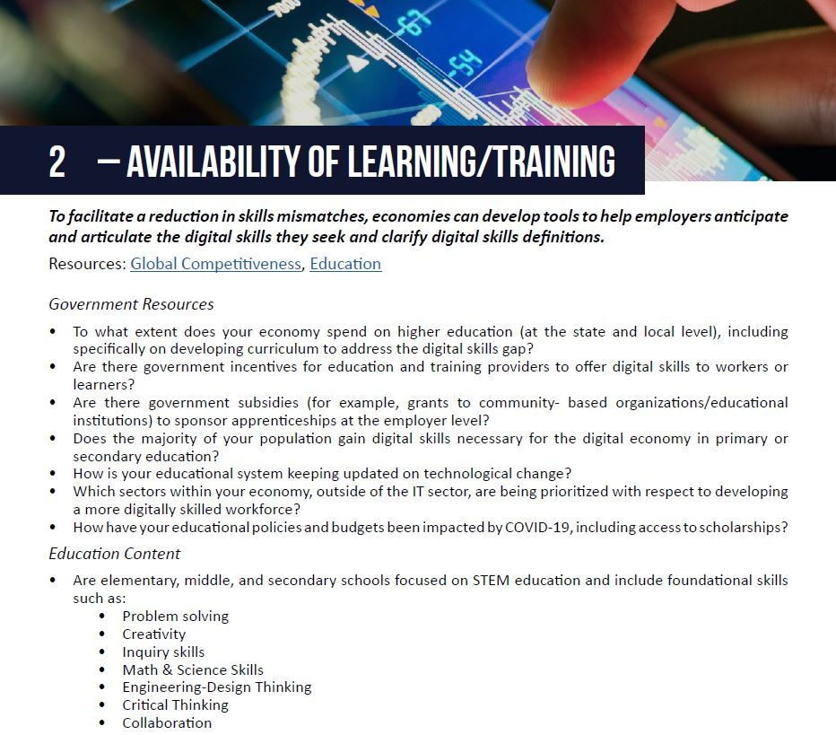
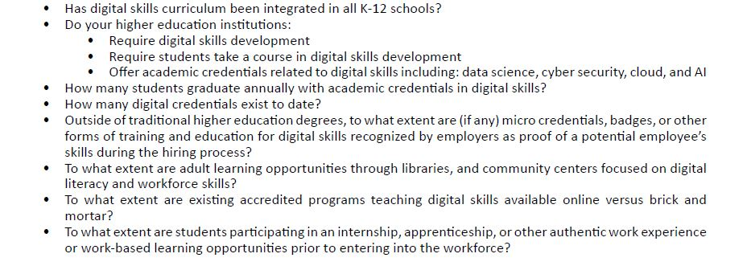

Slide 6
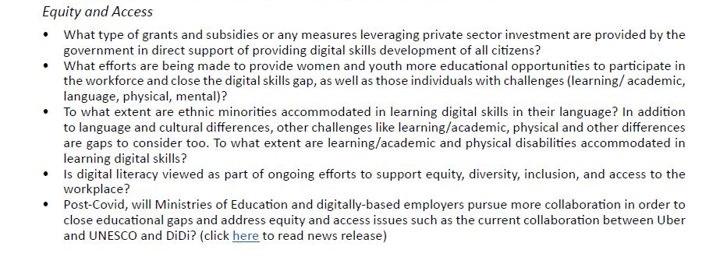

Slide 7
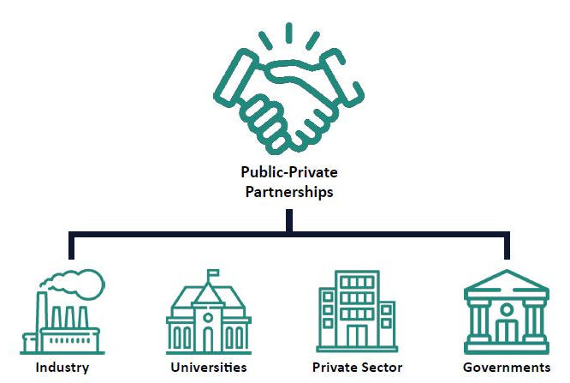

Slide 9
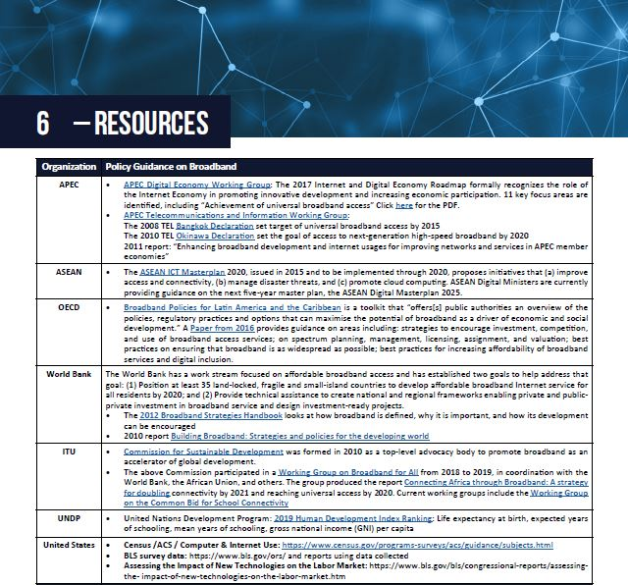
Call for additional Resources
We welcome further resources as we continue to update this Checklist.

Slide 10
Questions
Does this checklist provide enough baseline criteria to self-evaluate your economy’s digital readiness?
What industries in your economy are making the most progress in actualizing digital skills training and implementation?
How do you motivate employees to complete training? Do you provide time for training?
How do you assess current digital skills? Do you have a scaleable solution and process to implement this?
How do balance both non-digital and digital skills in the actual training process?

